Slide 1
MMME4054 Week 4 – Situation Awareness
Dr Kyle Harrington

Slide 2
Recap 1
What did you learn last week?
Notes:
Attention and workload

Slide 3
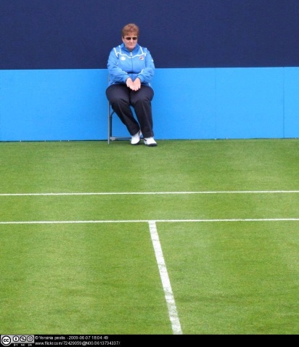
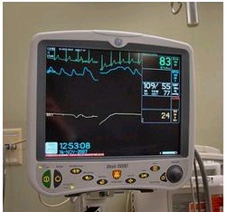
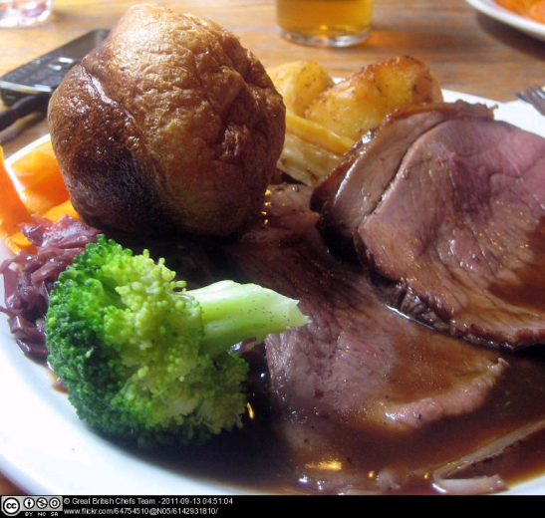
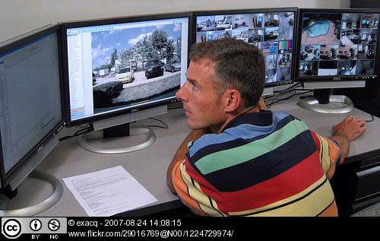
Attention – different types
Selective attention Our ability to selectively attend to a stimuli while ignoring irrelevant stimuli. | Focused attention Our ability to have our attention “caught” by a specific stimulus; ability to concentrate on a stimulus.
Divided attention Two or more separate tasks must be performed simultaneously and attention must be paid to both | Sustained attention Monitoring or vigilance tasks requiring the detection of infrequently occurring signals over prolonged periods of time (Signal detection theory)

Slide 4
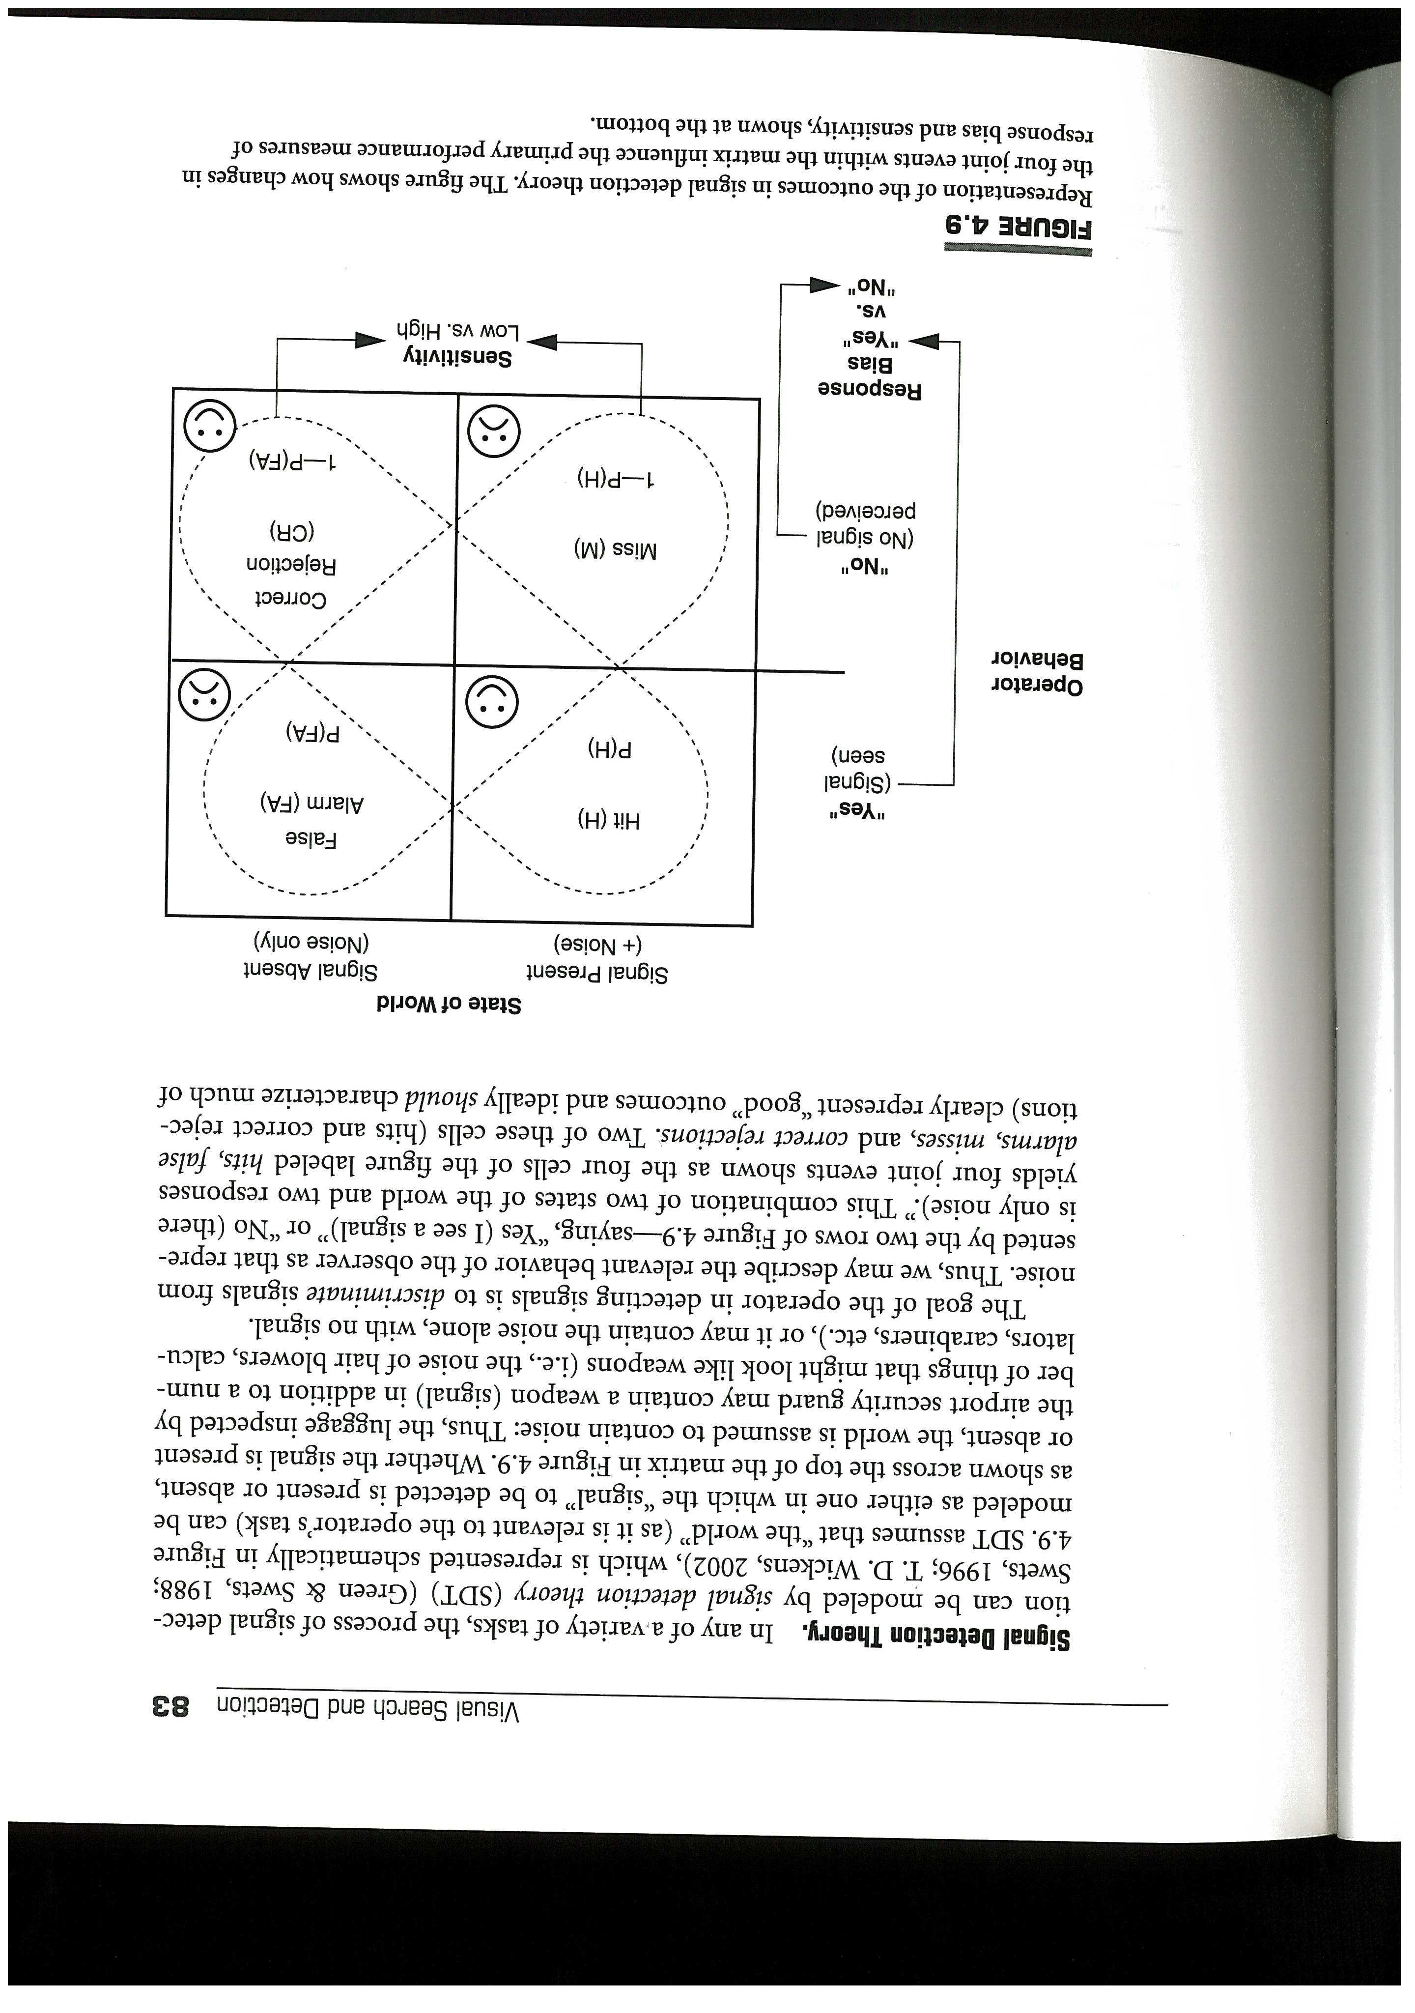
Signal detection theory
Detection of signals in ‘world’​
Assumption of noise present in world​
E.g. non dangerous items in luggage​
Aim: discriminate signals from noise​
Four outcomes: ​
Hit (signal present)​
Correct rejection (only noise present)​
False alarms (think signal present when not)​
Miss (fail to detect signal that is present)​

Slide 5
Limited resources model
Limited resources model
Impact of underload on performance
Dip in performance whilst still spare capacity due to data limitation
Good
Variable level of
available
resources
Less graceful decline in performance – ‘precipice of performance’
Performance
Resources
allocated
Variation in rate at which resources allocated due to expertise
Poor
Resources demanded by the primary task
Notes:
Resources available can vary (e.g. fatigue, motivation)
Expert uses up resources more slowly
Underload can degrade performance (through either lowered arousal or reduced attentional resources)
Precipice – research in ATC suggests degradation in performance is not constant.
Resource vs. data-limited performance. Resource limited – don’t have enough attention to attend to all tasks. Data limited – can’t perceive fault due to perceptual limitations in visual processing.
There is a work context – usually more than one task. Therefore task switching, and associated task switch cost.

Slide 6
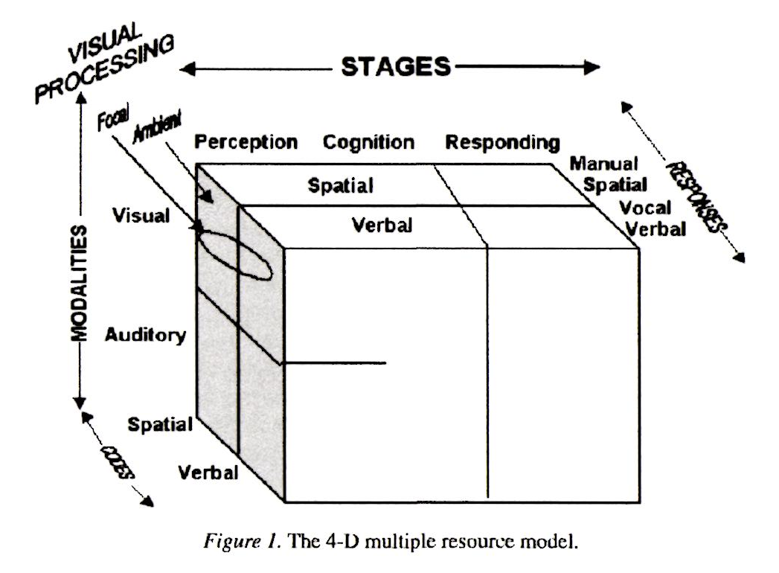
Multiple resources theory (Wickens, 2008)
Notes:
Wickens 2008 – most important application is to suggest design changes when in conditions of multitask overload
Mid 70s – evidence for more than 1 pool of resources
Wickens created this model (or rather the first version of this model 1980s) based on a meta-analysis of performance sharing studies.
The less tasks share resources, the better timesharing will be.
Auditory spatial – locating something
Auditory verbal – speech
Visual spatial – navigation
Vocal=voice; verbal=words
Visual verbal – reading
Visual focal (foveal)/ambient (peripheral)
Future work: add a tactile modality dimension; understanding the factors that occur in addition to resources that affect dual task performance; understanding what drives attentional allocation (e.g. when to respond to interruptions).

Slide 7
Learning objectives – situation awareness
Module LO’s:
LO1 –Describe how humans process information and how this applies in a variety of working contexts.
LO2 –Evaluate the range of subjective and objective assessment methods available to measure cognitive work performance.
LO5 – Recognise the variety of products and work contexts to which cognitive ergonomics design practice and guidance can be applied.
Lecture objectives:
Introduce Situation Awareness, and Endsley’s model of SA
Understand the link between SA and other HF characteristics
Understand different methods of SA measurement
Consider the above in the context of design

Slide 8
Recommended reading
Endsley, M.R., 1995. Toward a theory of situation awareness in dynamic systems. Human factors, 37(1), pp.32-64.
Endsley, M.R., 1988, May. Situation awareness global assessment technique (SAGAT). In Proceedings of the IEEE 1988 national aerospace and electronics conference (pp. 789-795). IEEE.
Taylor, R. M. (1990). Situation awareness rating technique (SART): the development of a tool for aircrew systems design. In Situational Awareness in Aerospace Operations (Chapter 3). France: Neuilly sur-Seine, NATO-AGARD-CP-478.
Brief texts on SA are available in other text books, e.g. Evaluation of Human work
Mica Ensley is really the guru of Situation Awareness – you can look at pretty much any of her work!

Slide 9
Situation awareness – Definition
“The perception of the elements in the environment within a volume of time and space, the comprehension of their meaning and the projection of their status in the near future” (Endsley, 1998)​
Consists of three hierarchical “cognitive levels”​
Higher level relies on outcome of the lower levels​
Level 1: Perception of the Elements in the Environment​
Level 2: Comprehension of the current situation​
Level 3: Projection of future status​
What’s happening? / What does it mean? / What will happen next?
SA = more than simply perceiving information about the environment

Slide 10

Situation awareness – Case Study (slide 1 of 3)
In 2009, Air France Airbus A330, flying from Rio de Janeiro to Paris crashed in Atlantic ocean – all 228 people died.
Ice crystals disabled airspeed indicators
Autopilot and auto thrust disengaged
At this time, the Captain was asleep
Manual control of the aircraft – controls were more sensitive due to disengaged autopilot.
Pilots were not used to manually flying the aircraft
They struggled to control the plane, leading to aerodynamic stall
Aircraft fell for four minutes, crashing into the ocean
Notes:
Aerodynamic stall: occurs when the angle of attack, pitch or attitude becomes too large, causing lift (upwards mechanical force) to suddenlty decrease. Recovery requires reorienting aircraft so that attack angle is low enough for lift to be restored.
Disabled airspeed indicators – aircraft was otherwise okay.
Autopilot and auto thrust disengaged – because of lack of airspeed input
Manual control - within one minute of the autopilot disconnecting, the aircraft was outside its flight envelope due to the manual inputs.
Pilots are scheduled breaks – but most experienced pilot was out at the time of the issue.
The crew focused on certain indicators, but ignored others. They expected bad weather, and so they thought that the aircraft shaking was due to turbulence, rather than a stall. This expectation was combined with their mental model that the aircraft would not allow them to cause a stall – but with the autopilot disconnected, different control rules applied and their assumptions were incorrect. In this mode, there are less restrictions on pilot inputs – without an autopilot, it IS possible to stall an airplane.
After losing airspeed, the Pilot Flying thought that they were losing height and pulled the nose up, contributing to the stall. Most pilot training in upsets had involved scenarios where the aircraft is close to the ground and so their automatic response is to pull the aircraft up. Automatic responses are more likely when stressed or under time pressure. The corrective action in this rapidly-deteriorating situation would have been to initiate a descent.
Controls were more sensitive – plane started to roll, and the pilot over compensated.
They actually lifted the nose, and beyond a certain lift, this leads to aerodynamic stall – sudden reduction in lift as plane exceeds critical value. Engines were fine. There were stall wwarnings – but they never referred to this. The crew didn’t seem to realise that they’d entered aerodynamic stall.

Slide 11
Situation awareness – Case Study (slide 2 of 3)
Quotes from the cockpit voice recorder:
“What the hell are you doing?” {captain}
“We’ve totally lost control of the plane. We don’t understand at all… {captain}
“What do you think? What should we do?” {captain}
“Well, I don’t know!” {captain}
“We still have the engines! What the hell is happening? I don’t understand what’s happening”
“Damn it, I don’t have control of the plane”
Notes:
Lots of confusion
No mention of the stall warning
No announcmement to passengers; no emergency message. Oxygen masks were not deployed, cabin crew were not seated.

Slide 12
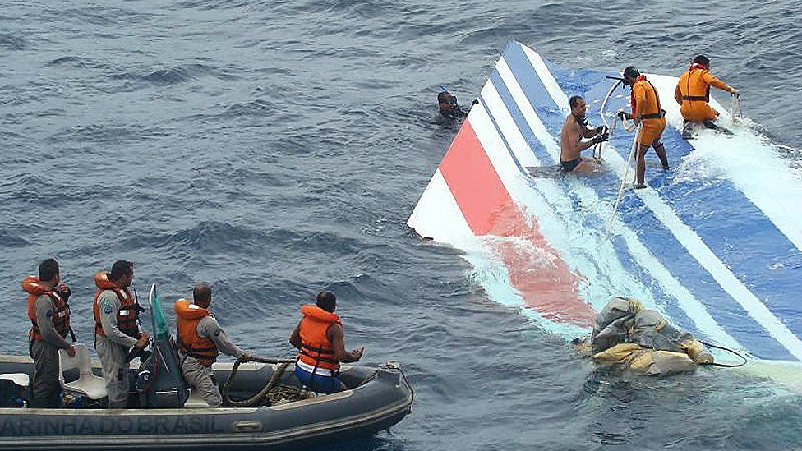
Situation awareness – Case Study (slide 3 of 3)
Situation awareness factors:
Apparent lack of perception of stall warning {perception}
The crew were confused by inconsistent air-speed readings {comprehension}
Confusion caused by alarms warning of the autopilot turning off {comprehension}
Automation reduced the pilots’ understanding of the situation {comprehension}
Loss of autopilot startled pilots, interrupting information processing, and led to reactive process (rather than anticipatory) and “tunnel vision”. {projection}
After this event, unexpected and unusual situations are incorporated in pilot training – i.e. training to improve situational awareness.
Notes:
Airspeed readings affected by ice crystals on pitot tubes (which measure airspeed)
Flight recorders were only recovered 2 years later using remote controlled submarines.
Tunnel vision – they were fixated on turbulence, rather than realising the aerodynamic stall.

Slide 13
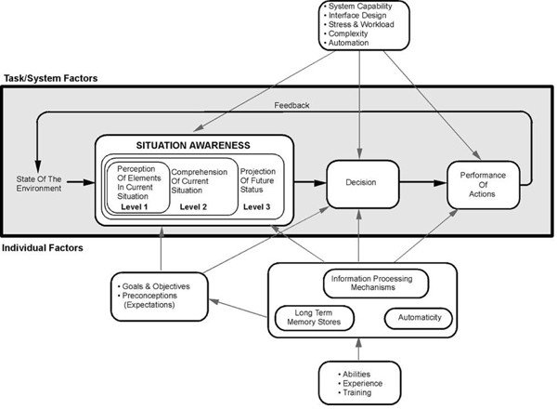
SA– Endsley’s model
Image source: Endsley, M.R., 1995. Toward a theory of situation awareness in dynamic systems. Human factors, 37(1), pp.32-64.

Slide 14
Situation awareness – Introduction
Enhancing operator situation awareness (SA) is a major design goal in developing interfaces (originated from aircraft piloting domain)​
Operators ‘must perceive and comprehend a dazzling array of data which is often changing very rapidly’ (Endsley, 2000)​
Problem is not lack of information but finding appropriate information at the correct time​
Information must be usable cognitively. Does the system design support the user in gaining the needed information under dynamic operational constraints?

Slide 15
Situation awareness – Characteristics
SA has always existed, new emphasis on it because technically we can do more to provide good SA through new system interfaces (or could negatively affect it with poor design!)​
Highly temporal in nature​ - changes continuously in dynamic environments
Cannot be built up instantaneously, but forms over time​
​Has to be distinguished from the processes used to achieve it​
SA cues can be received through all our senses (people are very active in SA process)​
Does NOT comprise “static knowledge sources” such as procedures, rules and checklists​
Importance of operator goals ​
Has a close relationship with, but is separate from, decision making.​

Slide 16
Factors relating to SA: decision making
Theoretically SA, decision making and performance can be seen as three stages each affecting the other​
Poor SA does not necessarily lead to poor performance​
Possible to have good SA but make incorrect decisions
Conversely, an operator with poor SA may make good decisions leading to good performance

Slide 17
Factors related to SA: Attention
How a person directs attention when acquiring and processing information has a fundamental impact on SA
May be affected by:
Operator experience
Operator understanding of the system
Physical characteristics of the environment

Slide 18
Factors related to SA: Perception
A critical component of SA
Detection, identification and recognition
May be affected by:
Experience and expectations
Long term memory (e.g. expert behaviour)
NB errors at perceptual level are common

Slide 19
Factors related to SA: Memory
Limits of working memory pose a constraint on SA
Strategies used by operators to reduce the working memory load include (Durso and Gronlund, 1999):
Use of meaningful chunks,
Information prioritisation
‘gistification’ of information
There is a correlation between LTM and SA at expert level
Experienced operators develop internal models of the systems they operate and of the environments in which they operate

Slide 20
Factors related to SA: Workload
Inter-related, independent constructs
 | Low SA | High SA
High workload | only able to attend to subset of required information, possibly inability to put together separate pieces of information | Person is working hard, but successfully achieving an accurate and complete picture of the situation
Low workload | person has little idea of what is going on, not actively working to find out | Required information presented in manner that is easy to process – the ultimate design goal

Slide 21
Reminder of Endsley’s model
Image source: Endsley, M.R., 1995. Toward a theory of situation awareness in dynamic systems. Human factors, 37(1), pp.32-64.

Slide 22
Activity
For each of the following examples, think of aspects that may relate to each of the three levels; and how design might be able to facilitate a better SA.
ACTIVITY!!!!
Notes:
Clues on next slide

Slide 23


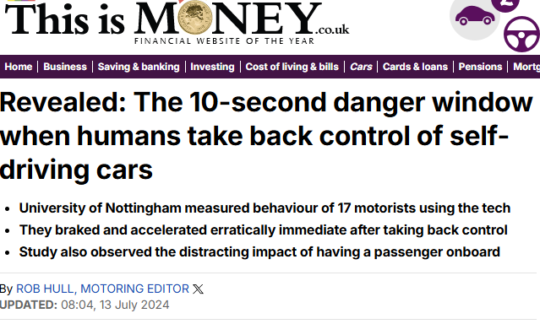
Microbreak – Handover Tasks in Autonomous Vehicles
Notes:
Clues on next slide

Slide 24


Microbreak – Surgery/Robotic Assisted Surgery
Notes:
Clues on next slide

Slide 25

Microbreak – Multiplayer, Online Competitive Games
Notes:
Clues on next slide

Slide 26
Situation awareness – is it a folk model?
Dekker and Hollnagel (2004) paper discusses the propensity of Human Factors professionals to adopt folk models (common-sense models)
They argue that with folk models, the value of the constructs… “hinges on their common-sense appeal rather than their substance”
They also posit that SA is a “postulated psychological mechanism” which is not “sufficiently articulated”.
Dekker and Hollnagel (2004) also criticise the “overgeneralisation” of folk models
“…that the same set of empirical phenomena can comfortably be grouped under either label – complacency or loss of situation awareness – is additional testimony to the undifferentiated and underspecified nature of these concepts” (spicy stuff!!!)
Dekker and Hollnagel (2004) see the solution as focussing on characteristics of performance (with reference to some kind of theory or model)
Dekker, S. and Hollnagel, E., 2004. Human factors and folk models. Cognition, Technology & Work, 6(2), pp.79-86.

Slide 27
Refute by Parasuraman et al. (2008)
Folk psychology is an important starting point for further investigation
There is in fact a large body of empirical evidence supporting SA
SA is diagnostics of different human operator states…and can therefore be used to identify HF remedies
SA is clearly defined (a “ground truth” continuous diagnosis of the dynamic world), and is not the subsequent choice or decision…SA is not “performance”
D&H (2004) “neglect the vast body of supporting evidence for the usefulness of SA in cognitive engineering design and training”
The three levels of SA can be assessed.
Parasuraman, R., Sheridan, T.B. and Wickens, C.D., 2008. Situation awareness, mental workload, and trust in automation: Viable, empirically supported cognitive engineering constructs. Journal of cognitive engineering and decision making, 2(2), pp.140-160.

Slide 28
Situation awareness measurement 1
Process Indices​
verbal protocol​
eye tracking​
Behaviour Measures​
E.g. verbal communications​ Time to make response​
But need overt actions
Performance Measures​
E.g. navigation performance and aircraft control (Andre et al., 1991)​
BUT focus on outcome rather than SA itself​

Slide 29
Situation awareness measurement 2
Subjective techniques​
e.g. Situational Awareness Rating Technique (SART) (Taylor, 1990)​
Operators rate a system design based on amount of demand on attentional resources, supply of attentional resources, and understanding of the situation provided​
Probe techniques​
More detailed questioning about task requirements​
Interrupt task to obtain instant report of current SA​
Situation Awareness Global Assessment Technique (SAGAT) (Endsley, 1987) queries about all three levels of SA​

Slide 30
Situation awareness measurement - SAGAT
SAGAT (Endsley 1988)– simulation based, and simulation is paused to query aspects of SA. Based on perception, comprehension, projection.
Define the tasks to be analysed
Conduct Hierarchical Task Analysis (HTA)
Conduct an SA requirement analysis
Select participants
Brief participants
Pilot run
Perform task (on appropriate simulation)
Pause simulation to ask pre-defined SA queries
Compare answers to what was actually happening
Calculate SA score
Endsley, M.R., 1988, May. Situation awareness global assessment technique (SAGAT). In Proceedings of the IEEE 1988 national aerospace and electronics conference (pp. 789-795). IEEE.

Slide 31
Situation awareness measurement – SAGAT (1)
SAGAT – what might be the limitations?
Endsley, M.R., 1988, May. Situation awareness global assessment technique (SAGAT). In Proceedings of the IEEE 1988 national aerospace and electronics conference (pp. 789-795). IEEE.

Slide 32
Situation awareness measurement – SAGAT (2)
SAGAT – what might be the limitations?
Requires simulator
Queries are intrusive to primary task
Pausing is disruptive
Limited applicability in real world
Not suitable for team SA

Slide 33
Situation awareness measurement - SART
Situation Awareness Rating Technique (SART, Taylor, 1990)
Quick method of self-assessing SA
Subjective rating method, against themes of
Demands on attentional resources
Supply of attentional resources
Understanding of the situation
We’re going to give it a go!
Taylor, R. M. (1990). Situation awareness rating technique (SART): the development of a tool for aircrew systems design. In Situational Awareness in Aerospace Operations (Chapter 3). France: Neuilly sur-Seine, NATO-AGARD-CP-478.

Slide 34
SART SA=U-(D-S)
Demand (reduces) | Instability of situation | How changeable is the situation? Is the situation highly unstable and likely to change suddenly (high), or is it very stable and straightforward (low)?
 | Complexity of situation | How complicated is the situation? Is it complex with many interrelated components (high) or is it simple and straightforward (low)?
 | Variability of situation | How many variables are changing in the situation? Are there a large number of factors varying (high) or are there very few variables changing (low)?
Attentional supply (increases) | Arousal | How aroused are you in the situation? Are you alert and ready for activity (high) or do you have a low degree of alertness (low)?
 | Concentration of attention | How much are you concentrating on the situation? Are you bringing all your thoughts to bear (high) or is your attention elsewhere (low)?
 | Division of attention | How much is your attention divided in the situation? Are you concentrating on many aspects of the situation (high) or focussed on only one (low)?
 | Spare mental capacity | How much mental capacity do you have to spare in the situation? Do you have sufficient to attend to many variables (high)
Understanding (increases) | Information quantity | How much information have you gained about the situation? Have you received and understood a great deal of knowledge (high) or very little (low)?
 | Information quality | How good is the information you have gained about the situation? Is the knowledge communicated very useful (high) or is it a new situation (low)?
 | Familiarity with situation | How familiar are you with the situation? Do you have a great deal of relevant experience (high) or is it a new situation (low)?

Slide 35
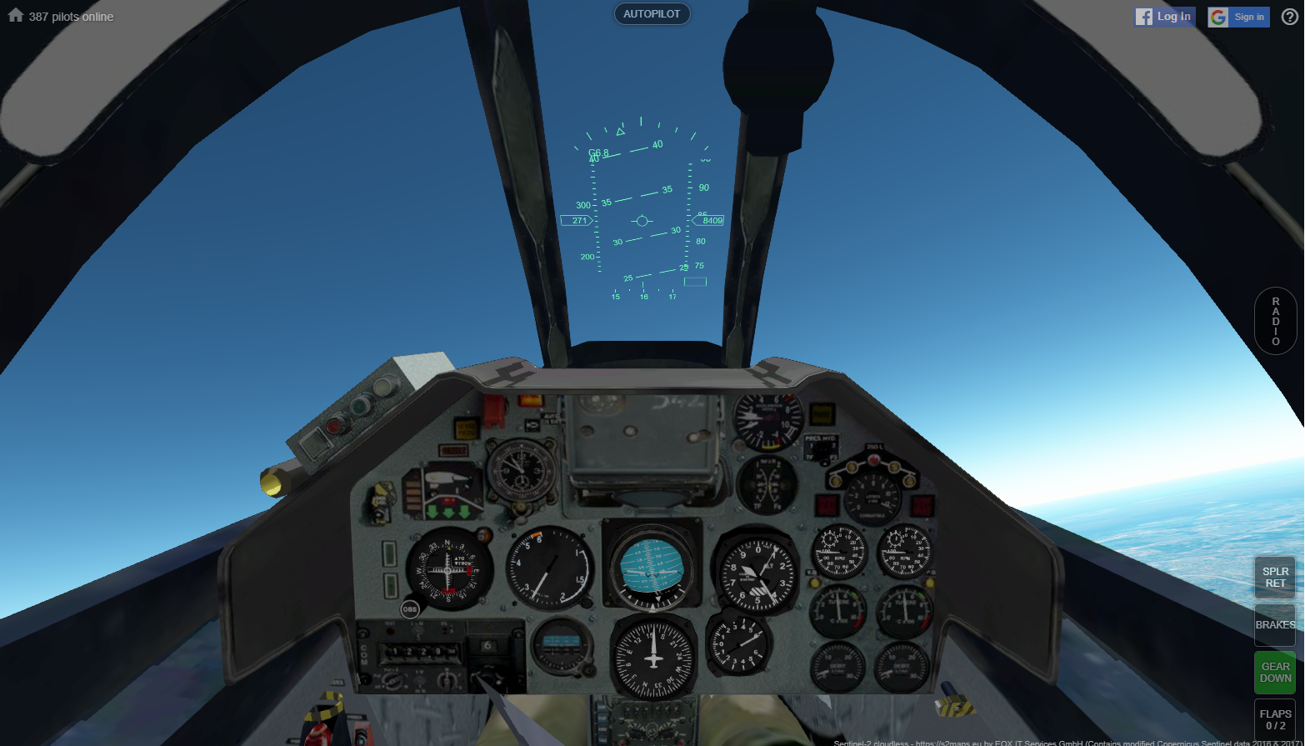
SART example
Play the geo-fs aeroplane simulator – shouldn’t be any need to download anything, nor enter any personal details – link to the simulator – if any problems, just watch on Kyle’s screen.
DO NOT ATTEMPT (OR EVEN WATCH!) IF YOU SUFFER FROM MOTION SICKNESS, EPILEPSY, MIGRAINES, DIZZINESS, BLURRED VISION OR ARE (OR MAY BE) PREGNANT
ACTIVITY!!!!

Slide 36
SART example – complete the form
Now complete the SART 10D rating sheet…
https://forms.office.com/e/eJrpPv1mNa

Slide 37
SART review
Pros
Quick to administer, low cost
Applicable across a range of applications
Widely used method
Cons
Can confuse SA with performance
Unaware of own limited SA
Retrospective – memory accuracy?
Intrusive if administered during task
Limited portion of SA – anything on projection?
Any other thoughts…

Slide 38
Situation awareness – case study conclusions
In conclusion we see evidence of situation awareness:
Perception – of alarm, of other people
Comprehension – trying to work out what’s going on
Projection – what’s going to happen? Will it get worse? How urgently do I need to evacuate?

Slide 39
Implications for design – situation awareness
Provide displays and interfaces that allow SA to be maintained​
Consider enabling projection using additional interface elements (e.g. Projected movement of aircraft)​
Ensure knowledge in the world to reduce memory burden for SA maintenance​
Consider how different methods of SA measurement can be used to inform design and embed HF in integrated decision making​

Slide 40
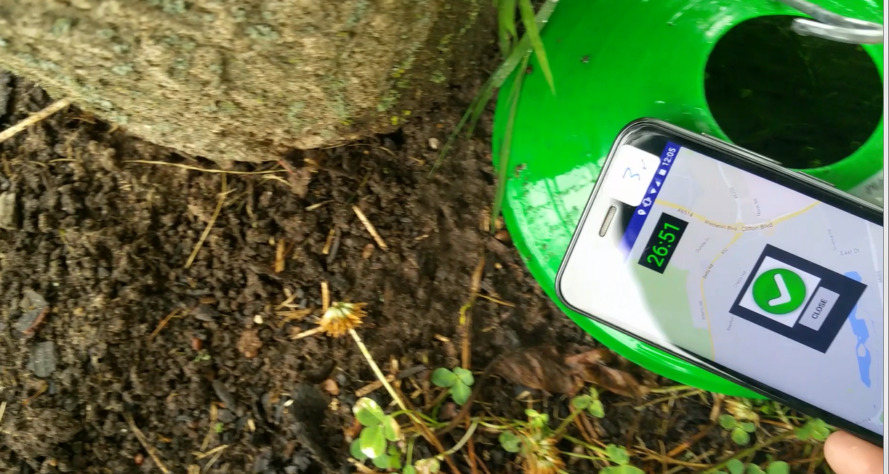
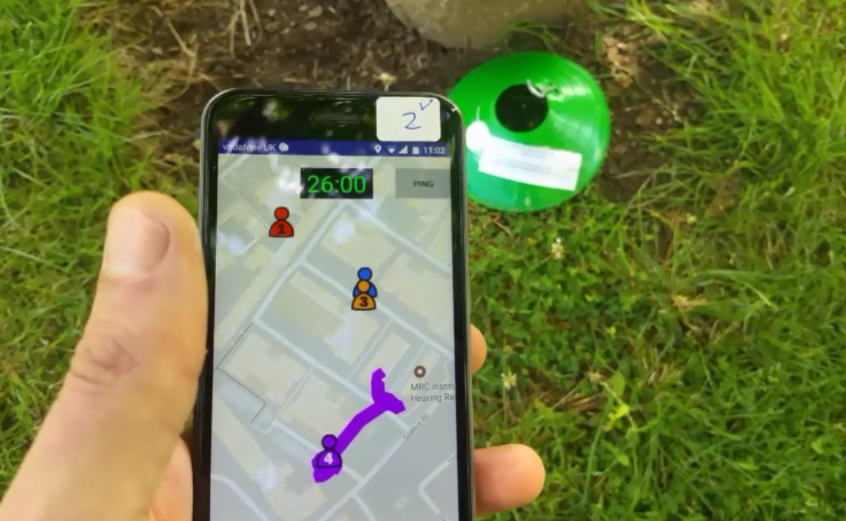
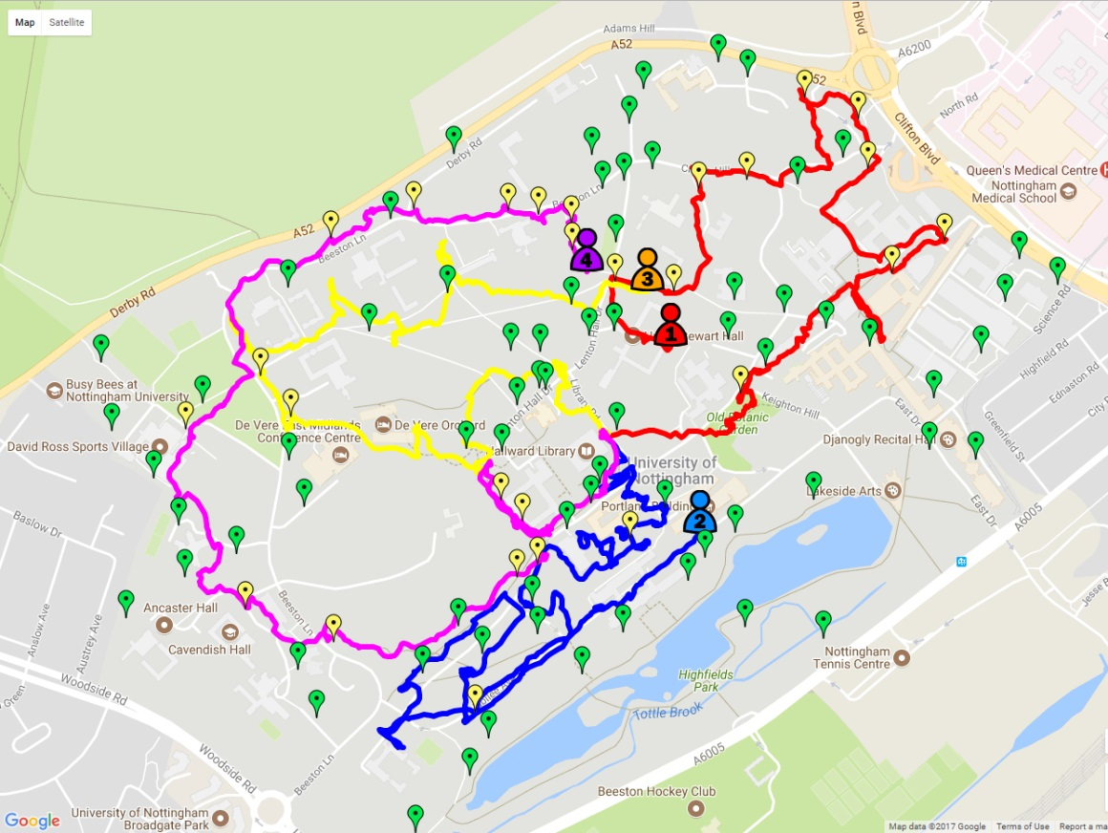
Investigating SA – Case Study (Harrington et al 2021)
Final PhD study looking into whether an app could help people conduct better searches in teams.

Slide 41

Investigating SA – Case Study (Harrington et al 2021)
Participants assigned to one of four conditions (shared audio/phone calls only – seeing locations of others/only own location
Find as many sports cones around campus as you can in 24 hours!
Outcome measures; total cones found, SART score, “map score” (objective SA measure).

Slide 42
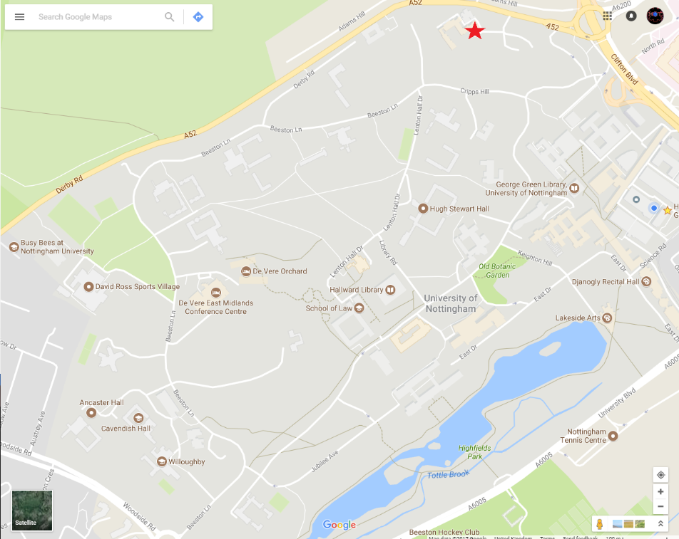
Investigating SA – Case Study (Harrington et al 2021)
“How many meters did each person walk?”
Who was closest to X cone?
How many cones did each person find?

Slide 43
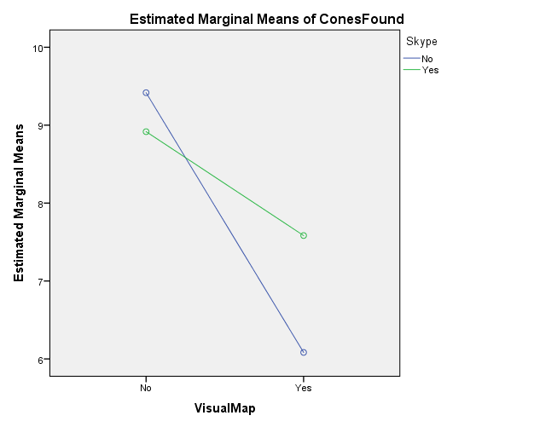
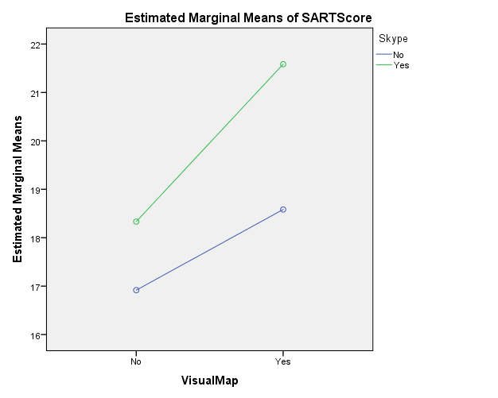
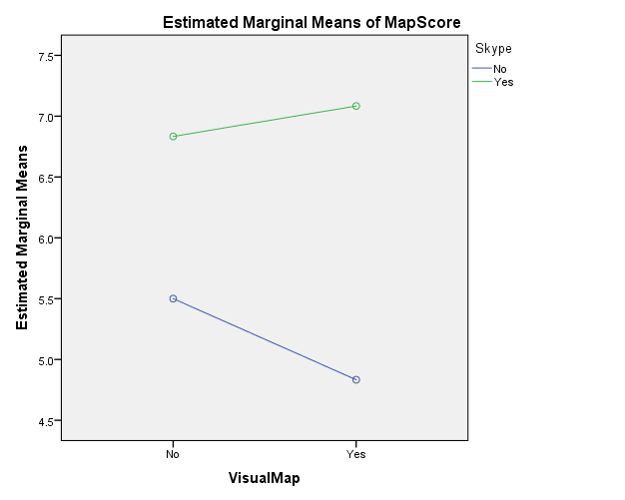
Investigating SA – Results
Having shared map actually made search task performance worse (though not significant)
People self-reported higher SA (SART) with the shared map, and this was significant
People scored more highly on Objective SA with the shared audio (and this was significant)
No significant correlation between SART and Mapscore 😐

Slide 44
Investigating SA – Take Home
Conditions with high subjective ratings of SA were not conditions of the best performance
Shared audio improved objective SA more than shared visuals
Was the “map score” also a memory test?
Perhaps the audio only forced deeper semantic processing, and this encouraged greater retention.
“Definitely helped being able to hear other people, getting an idea of which area they were in”, AO, trial 1
“Skype calls would be better if you could have group calls as well”, VO, trial 2.
“Given that we were able to see where we were on the map, I’m wondering whether it would be able to see where everyone else was on the map, so that way you could kind of co-ordinate a bit better”, AO, trial 3.
“I think it’s maybe not the best idea looking at the screen when you are running around, but the map is really useful. So perhaps I wouldn’t look at the screen all the time, but I found myself looking at the screen a lot”, FF, trial 3.
“At one point I was looking at the screen and I walked into a building, without looking”, FF, trial 2

Slide 45
Time to ask Kyle questions about coursework…

Slide 46
Any questions? Kyle.Harrington@nottingham.ac.uk

Slide 47
Referencing Software
EndNote (University Licence) or Mendeley.
Keep track of the things you read.
Integrates into Microsoft word (and other office programs – e.g., Publisher for posters, PowerPoint for presentations).
Allows you to create reference lists with less effort.
Can help you to keep track of notes about each paper.
Allows you to organise papers into categories.

Slide 48




Slide 49
Finding Academic Literature Online
Search Engines (Google Scholar, PubMed, Microsoft Academic)
Key terms, Boolean operators.
Systematic literature reviews and scoping reviews are like goldmines for relevant work!
Check citation counts, look at where it is published and what department was responsible for the research.
Scan abstracts for relevance.
Read paper, download citation and give synopsis.
It’s a good idea to keep a word document with descriptions of the papers you read in your own words. Then when it’s time to write coursework, you will have plenty of content.

Slide 50
Finding Academic Literature Online (RG)
Make an account on ResearchGate.Net
Find academics and researchers in your own department and see their papers and research interests.
Ask and answer questions from other researchers.
Discover key-terms, and open research questions.

Slide 51
More tips on using references
Factual claims which require support need references (some wiggle room here, but if in doubt use a reference).
Direct quotations need references AND page numbers.
References should be specific – I should be able to read your sentence, see the reference and know exactly how the reference supports your point.
If you say something like “lots of researchers think this”, “studies have shown this”, provide more than one reference (or a reference to a consensus paper or systematic review)
Don’t pin all your talking points on too few references!
How old is the reference? For a definition or theory, it’s fine to use older references. But if you are talking about the “current state” of something, don’t use a 20 year old reference!

